Slide 1
File System Durability & Crash Recovery
Haibo Chen
Some of the materials are adopted from Frans’ 6.828 course

Slide 2
Review: Ext2
The good – ext2 supports:
All the features of ext…
… with even better performance (because of increased spatial locality)
The bad
Large files must cross block groups
As the file system becomes more complex, the chance of file system corruption grows
E.g. invalid inodes, incorrect directory entries, etc.

Slide 3
Review: From Pointers to Extents
Modern file systems try hard to minimize fragmentation
Since it results in many seeks, thus low performance
Extents are better suited for contiguous files
inode
block 1
block 2
block 3
block 4
block 5
block 6
inode
block 1
length 1
block 2
length 2
block 3
length 3
Each extent includes a block pointer and a length

Slide 4
Review: Example B-Tree
ext4 uses a B-Tree variant known as a H-Tree
The H stands for hash (sometime called B+Tree)
Suppose you try to open(“my_file”, “r”)
hash(“my_file”) = 0x0000C194
H-Tree Root
0x00AD1102 | 0xCFF1A412
H-Tree Node
0x0000C195 | 0x00018201
H-Tree Node
H-Tree Node
H-Tree Leaf
0x0000A0D1 | 0x0000C194
H-Tree Leaf
H-Tree Leaf
my_file → inode

Slide 5
FS Durability & Crash Consistency

Slide 6
File System Durability
Topic: tension between fs perf. and crash recovery
Disk performance is often a #1 bottleneck
"how many seeks will that take?”
Durability != Crash consistency
“Here is all of my data. But some of the metadata is wrong.”
Crash recovery is much harder than performance
"what if a crash occurred at this point?”

Slide 7
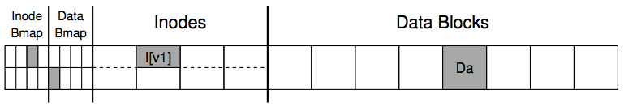
An Example: Append a File
Inside of I[v1]:
owner : haibo
permissions : read-only
size : 1
pointer : 4
pointer : null
pointer : null
pointer : null

Slide 8
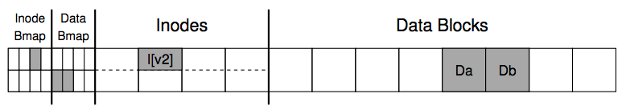
An Example: Append a File
Inside of I[v2]:
owner : haibo
permissions : read-only
size : 2
pointer : 4
pointer : 5
pointer : null
pointer : null

Slide 9
Crash Scenarios: 1 Succeeds
Imagine only a single write succeeds; there are thus three possible outcomes:
1. Just the data block (Db) is written to disk
What will happen?
2. Just the updated inode (I[v2]) is written to disk
What will happen?
3. Just the updated bitmap (B[v2]) is written to disk
What will happen?
Notes:
1. In this case, the data is on disk, but there is no inode that points to it and no bitmap that even says the block is allocated. Thus, it is as if the write never occurred. This case is not a problem at all, from the perspective of file-system crash consistency.
2. File system inconsistency!
3. Space leakage

Slide 10
Crash Scenarios: 2 Succeed
Two writes succeed and the last one fails:
1. The inode (I[v2]) and bitmap (B[v2]) are written to disk, but not data (Db)
2. The inode (I[v2]) and the data block (Db) are written, but not the bitmap (B[v2])
3. The bitmap (B[v2]) and data block (Db) are written, but not the inode (I[v2])
Notes:
Metadata is ok, but data is garbage
Metadata inconsistency!
Block leakage. No idea which inode the block belongs to.

Slide 11
Our Expectation
After rebooting and running recovery code
1. FS internal invariants maintained
E.g., no block is both in free list and in a file
2. All but last few operations preserved on disk
E.g., data I wrote yesterday are preserved
User might have to check last few operations
3. No order anomalies
$ echo 99 > result ; echo done > status

Slide 12
Our Assumptions
Simplifying assumptions:
Disk is fail-stop, disk executes the writes FS sends it, and does nothing else
Perhaps doesn't perform the very last write
Thus: no wild writes, no decay of sectors

Slide 13
Why is FS crash recovery hard?
Crash = halt/restart CPU
let disk finish current sector write, assume no h/w damage, no wild write to disk
Goal: automatic recovery
Can fs always make sense of on-disk metadata after restart?
Given that the crash could have occurred at any point?
Examples
Crash during mkdir, leave directory without . and ..
Crash during free blocks

Slide 14
Offline and Online Recovery
Offline recovery
file system check utility, such as chkdsk in windows and fsck on linux
E.g., ext3
Online recovery
during operation, check some important inconsistency
E.g., ext4 (also has offline fsck, but much simpler)

Slide 15
Terms for properties of fs ops
What effects will app see after restart + recovery
creat(“a”); fd = creat(“b”); write(fd,…); crash
Durable (Persistence): effects of operation are visible
Both a and b are visible
Atomic: all steps of operation visible or none
Either a and b are visible or none is visible
Ordered: exactly a prefix of operations is visible
If b is visible, then a is visible

Slide 16
Recovery approach
1. Synchronous meta-data update + fsck
Used in xv6-rev0
During check, synchronize metadata, such as file size
2. Soft update (FreeBSD fs modified on FFS)
not covered in this course
3. Logging (ext 3/4), xv6-rev6 and following versions
Before doing actual meta-data update, log the event
After crash, recover from log

Slide 17
Sync Metadata Update+ fsck

Slide 18
Typical set of tradeoffs
FS ensures it can recover its meta-data (minimal requirements for a real FS)
Internal consistency
No dangling references
Inode and block free list contain only used (not using) items
Unique name in one directory, etc.
Weak semantic FS provided limited guarantees
Atomicity for creat, rename, delete
Often no durability for anything
(creat(“a”), then crash, no a)
Often no order guarantees

Slide 19
How do applications handle this weak semantics?
Example
Edit your file, then crash, only half of your file is actually updated?
Fsync and rename (shadow copy)
Fsync force durability, only returned if file is actually written on disk
Rename is an atomic operation, only old name or new name, not half old half new
Mac OS intensively uses rename to ensure atomicity

Slide 20
What Does fsck do?
1. Check superblock
E.g., making sure the file system size is greater than the number of blocks allocated
If error, use an alternate copy of the superblock
2. Check free blocks
Scans the inodes, indirect blocks, double indirect blocks, etc.
Uses this knowledge to produce a correct version of the allocation bitmaps
Same for the inode bitmap

Slide 21
What Does fsck do?
3. Check inode states
Check type: regular file, dir, symbolic link, etc.
Clear suspect inodes and clear the inode bitmap
4. Check inode links
Check link count by scanning the entire fs tree
If count mismatches, fix the inode
If inode is allocated but no dir contains it, lost+found
5. Check duplicates
Two inodes refer to the same block
If one inode is obviously bad, clear it; otherwise, copy the block and give each a copy

Slide 22
What Does fsck do?
6. Check bad blocks
E.g., point to some out-of-range address
What should fsck do? Just remove the pointer
7. Check directories
The only file that fsck know more semantic
Making sure that “.” and “..” are the first entries
Ensure no dir is linked more than once
No same filename in one dir

Slide 23

Problem of fsck: Too Slow
How long would fsck take?
an example server: fsck takes 10 minutes per 70GB disk w/ 2 million inodes
clearly reading many inodes sequentially, not seeking
still a long time, probably linear in disk size
Consider the example before:
Scan the disk for only three disk block writes
Just like find a key by searching the entire house

Slide 24
Would an xv6 FS be internally consistent after a crash?
Xv6-rev0 strategy: carefully order disk writes to avoid dangling refs
1. initialize a new inode before creating dirent
2. delete dirent before marking inode free
3. mark block in-use before adding it to inode addrs[]
4. remove block from addrs[] before marking free
5. zero block before marking free
Has some visible bugs:
. and .. during mkdir(), link counts, sizes
Has some invisible loose ends
may lose freed blocks and inodes

Slide 25
Example
File creation: what's the right order of synchronous writes?
1. mark inode as allocated
2. create directory entry
File deletion
1. erase directory entry
2. erase inode addrs[], mark as free
3. mark blocks free

Slide 26
What about app-visible syscall semantics?
Durable? Yes
Use write-through cache, sync I/O, O_SYNC
Atomic? Often
Mkdir is an exception
Ordered? Yes
If all writes are sync

Slide 27
Recall: Sync I/O vs. Async I/O
Asynchronous I/O is a poor abstraction for:
Reliability
Ordering
Durability
Ease of programming
Synchronous I/O is superior but 100x slower
Caller blocked until operation is complete

Slide 28
Issues with Synchronous Write
Main issue
very slow during normal operation
very slow during recovery

Slide 29
Barrier: Flush the Disk
Disk’s write buffer
Disk will inform the OS the write is complete when it simply has been placed in the disk’s memory cache
But the data is not on disk yet! No durability! No order!
One solution: disable the buffer
Another solution: using flush operation
Force the disk to write data to disk media
Aka., disk write barrier
However, disks may not do as they claim…
Some disks just ignore the flush operation to be faster
“the fast almost always beats out the slow, even if it is wrong” --- Kahan”

Slide 30
Ordinary perf. of sync meta-data update?
Creating a file and writing a few bytes
Takes 8 writes, probably 80 ms
(ialloc, init inode, write dirent, alloc data block, add to inode, write data, set length in inode, xxx)
So can create only about a dozen small files per second! Think about un-tar or rm *

Slide 31
How to get better performance?
Reality
RAM is cheap
disk sequential throughput is high, 50 MB/sec (maybe someday solid state disks will change the landscape)
Why not use a big write-back disk cache?
*no* sync meta-data update operations
*only* modify in-memory disk cache (no disk write)
so creat(), unlink(), write() &c return almost immediately bufs written to disk later
if cache is full, write LRU dirty block
write all dirty blocks every 30 seconds, to limit loss if crash
this is how old Linux EXT2 file system worked

Slide 32
Write-back Cache
Would write-back cache improve performance? why, exactly?
after all, you have to write the disk in the end anyway
What can go wrong with write-back cache?
example: unlink() followed by create() an existing file x with some content, all safely on disk
one user runs unlink(x)
1. delete x's dir entry **
2. put blocks in free bitmap
3. mark x's inode free; another user then runs create(y)
4. allocate a free inode
5. initialize the inode to be in-use and zero-length
6. create y's directory entry **
again, all writes initially just to disk buffer cache
suppose only ** writes forced to disk, then crash
what is the problem?
can fsck detect and fix this?
Notes:
problem: no mechanism to make unlink(), create(), &c atomic with respect to crashes and (unlike sync metadata update) no ordering hints for fsck

Slide 33
Journaling

Slide 34
Logging (Journaling)
Goal:
atomic system calls with respect to crashes
fast recovery (no hour-long fsck)
speed of write-back cache for normal operations
Approach
will introduce logging in two steps
first xv6's log, which only provides safety
then Linux EXT3, which is also fast

Slide 35
Basic idea behind logging
To ensure atomicity:
all of a system call's writes, or none
let's call an atomic operation a "transaction"
record all writes the sys call *will* do in the log
then record "done"
then do the writes
on crash+recovery:
if "done" in log, replay all writes in log
if no "done", ignore log
this is a WRITE-AHEAD LOG

Slide 36
Xv6's simple logging
FS has a log on disk syscall:
begin_trans()
bp = bread()
bp->data[] = ...
log_write(bp)
more writes ...
commit_trans()
inodes
in-use bitmap
data block
Log block
unused
Super
block

Slide 37
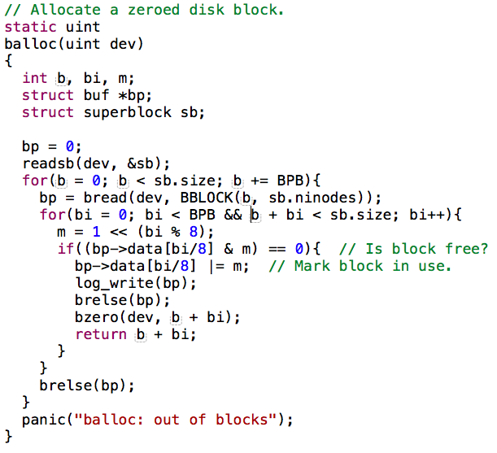
Recap: balloc
Update bitmap

Slide 38
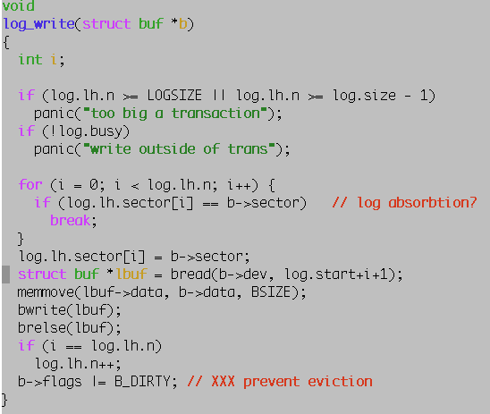
Notes:
// Caller has modified b->data and is done with the buffer.
// Append the block to the log and record the block number,
// but don't write the log header (which would commit the write).
// log_write() replaces bwrite(); a typical use is:
// bp = bread(...)
// modify bp->data[]
// log_write(bp)
// brelse(bp)

Slide 39
Transaction Semantics in xv6
begin_trans:
need to indicate which group of writes must be atomic!
lock -- xv6 allows only one transaction at a time
log_write:
record sector #
append buffer content to log
leave modified block in buffer cache (but do not write)
commit_trans():
record "done" and sector #s in log
do the writes
erase "done" from log
recovery:
if log says "done": copy blocks from log to real locations on disk

Slide 40
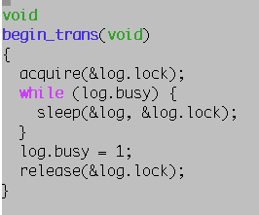
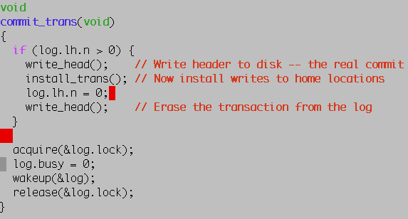

Slide 41
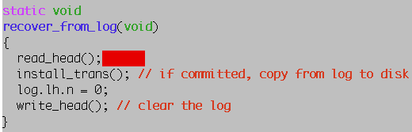
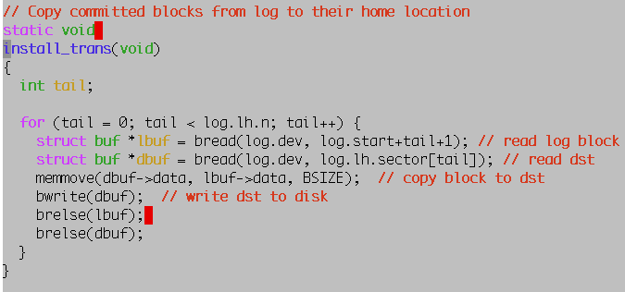

Slide 42
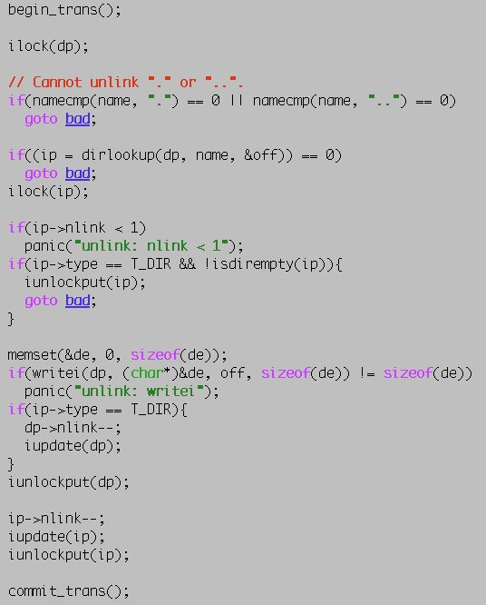
Sys_unlink
struct inode *dp = nameiparent(path, name)
Notes:
sys_unlink, begin_trans before ilock to avoid deadlock then error checks, which need the inode lock on err, commit empty transaction writei of dirent iupdate and iunlockput of file thus freeing of blocks, erasing of addrs[], freeing inode commit_trans begin_trans, sheet 41 why only one transaction at a time? log_write commit_trans write_head install_trans recover_from_log

Slide 43
Limitation with xv6 logging
Only one transaction at a time
two system calls might be modifying different parts of the FS
synchronous write to on-disk log
each write takes one disk rotation time
commit takes another
a file create/delete involves around 10 writes
thus 100 ms per create/delete -- very slow!
tiny update -> whole block write
creating a file only dirties a few dozen bytes
but produces many kilobytes of log writes
synchronous writes to home locations after commit
i.e. write-through, not write-back
makes poor use of in-memory disk cache

Slide 44
Questions
How can we get both performance and safety?
we'd like system calls to proceed at in-memory speeds
using write-back disk cache
i.e. have typical system call complete w/o actual disk writes

